Slide 1
Clinical History taking

Slide 2
Objectives
Understand the purpose of clinical history taking
Understand the sequence of history taking
Have Insight into the skills of history taking

Slide 3
History Taking
3 main aims
Build a therapeutic relationship
Build and test hypotheses – differential diagnosis
Identify the systems or organs responsible for the symptom (s)

Slide 4
The Skilled Interviewer
Listen – This allows the patient to ‘tell the story’ in their own words. Encourage the flow with verbal and non verbal cues.
Try not to interrupt
Clarify – Exact nature of any vague or colloquial terms used by the patient, times of events, or gaps in the story
Ensures that you have all the information

Slide 5
The Skilled Interviewer
Question – Specific areas of relevance, use open questions while avoiding leading questions
Summarise – Outline the narrative as you understand it.
Invite the patient to correct any inaccuracies by echoing back the story.
  Can inform the future clinical decisions & clinical judgement

Slide 6
Avoid
Lecturing
Changing the subject
Jumping to conclusions
Defensive responses
Leading questions

Slide 7
Sequence of History Taking
• Introduction
• Presenting complaint
• History of presenting complaint - Functional enquiry of relevant system
• Past medical/surgical history
• Medication & allergies
• Social history
• Family history
• Functional systemic enquiry
• Patients perception of illness

Slide 8
Symptom Attributes
S-ite
O-nset
C-haracter
R-adiation
A-llieviating factors
T-iming
E-xacerbating factors
S-everity
P-recipitating factors
Q-uality
R-adiation
S-everity
T-imimg

Slide 9
Past Medical/Surgical History
• T - hyroid
• H - eart disease
• R - rheumatic fever
• E - pilepsy
• A - sthma
• D - iabetes
• T - TB
• J - aundice
• Surgery - What/when/scars/pre or post op complications
• Screening or diagnostic tests - When & outcome

Slide 10

Medication
•Including doses & timings
•Recreational
•Herbal
•Over the counter

Slide 11



Social History
•Living arrangements
•Social Services
•Employment
•Smoking (current & previous)
• Alcohol (current & previous)
Amount over ? Timescale
? house or bar

Slide 12
Family History
Have any family members suffered from a similar problem?
Are there any illnesses or conditions that run in the family like cancer / genetic / cardiac / diabetes etc
Have any family members died before the age of 60? –
  if so how many?

Slide 13
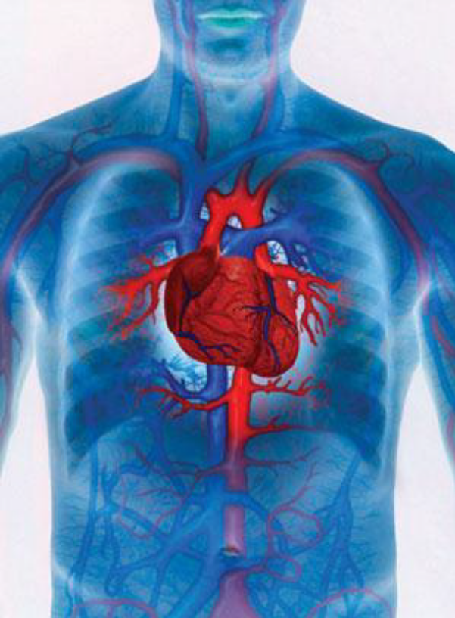
Specific System Questioning
Cardiovascular
• Chest pain
• Breathlessness
• Exercise tolerance
• Orthopnoea
• Paroxsymal nocturnal dyspnoea
• Palpitations
• Ankle swelling
• Claudication

Slide 14
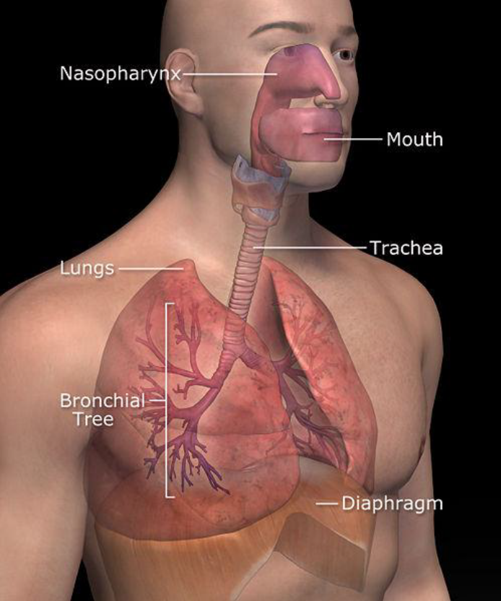
Specific System Questioning
Respiratory
• Cough
• Spit
• Wheeze
• Haemoptysis
• Head Cold

Slide 15
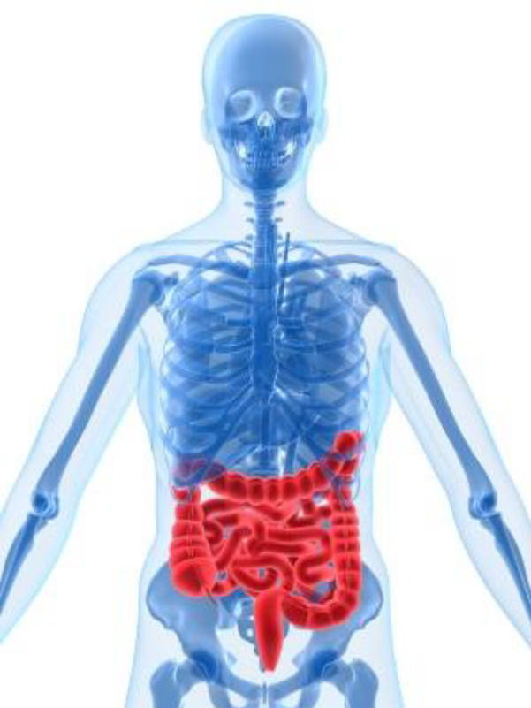
Specific System Questioning
Gastrointestinal
•Swallowing difficulties
•Acid reflux
•Nausea/vomiting
•Haematemsis
•Loss of appetite
•Weight loss
•Abdominal pain
•Change in bowel habit
•Change in colour/consistency of stool/urine
•PR blood/pus/mucus

Slide 16
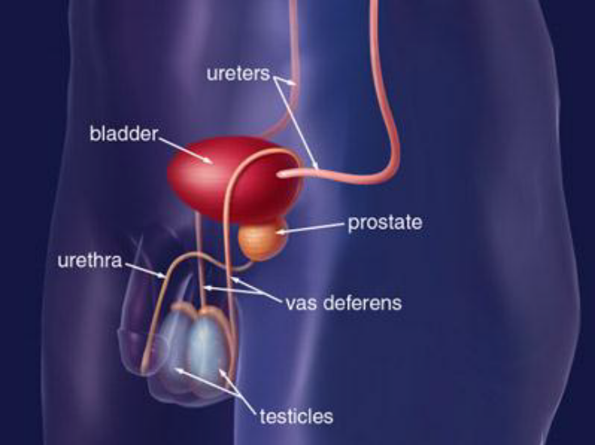
Specific System Questioning
Genitourinary
• Dysuria/burning
• Frequency/nocturia
• Change in colour/smell of urine
• Hesitancy/poor stream
• Intermittent flow
• Dribbling
• Urethral discharge
• Incontinence
• Menstrual cycle/difficulties – remember pregnancy

Slide 17
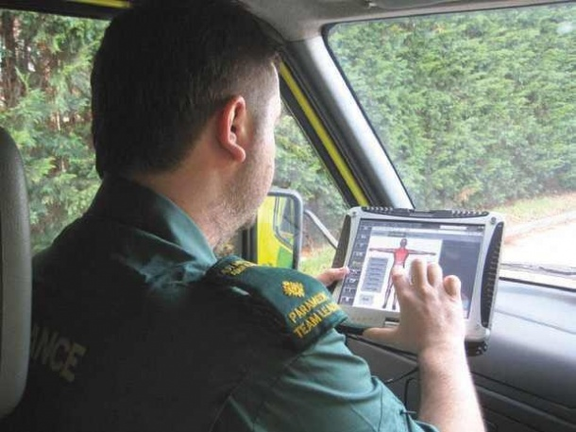
Recording the History
Date & time
Patients name
DOB & age
Type of admission
Presenting complaint
History of presenting complaint – including functional enquiry of the system affected
Systemic inquiry
Hypothesis /differential diagnosis

Slide 18

Remember
70% of diagnoses can be made based on history alone.

Slide 19
Sources of Information
•Bickley, L.S. (2007) Bate’s pocket guide to physical examination and history taking. 5th ed. Philadelphia: Lipincott Williams and Wilkins.
•Douglas, G., Nicol, F. & Robertson, C. (eds.) (2005) MacLeod’s clinical examination. 11th ed. Edinburgh: Elsevier
•Longmore, M., Wilkinson, I., Turmezei, T. & Cheung, K. C. (2007) Oxford Handbook of Clinical Medicine, 7th ed., Oxford University Press: Oxford
•Porth, C. A. & Matfin, G. (2009) Pathophysiology: Concepts of Altered Health States. 8th ed. Lippincott, Williams & Wilkins: Philidepphia.
•Singer, M. & Webb, A. (2004) Oxford Handbook of Critical Care. 2nd ed., Oxford University Press: Oxford.
•Tortora, G. & Derrickson, B. (2006) Principles of Anatomy and physiology. 11th ed. Wiley: New Jersey.
•http://www.direct.gov.uk
•http://www.heartstats.org
•http://www.isdscotland.org
•http://www.statistics.gov.uk

